Slide 1



HR Analysis
View in Power BI

Slide 2
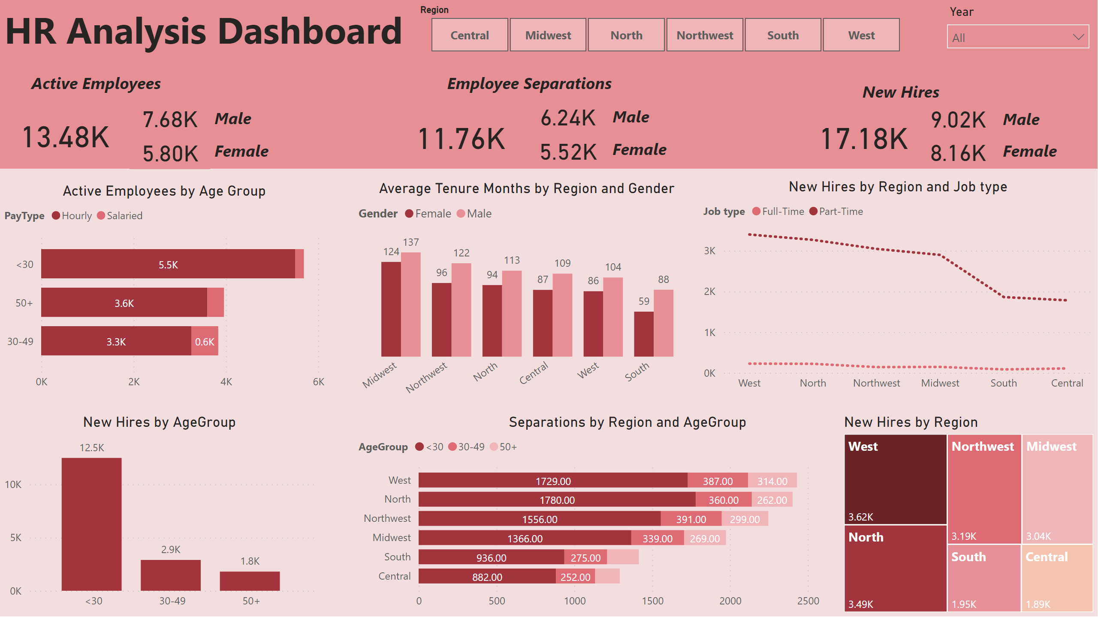
Analysis
Notes:
shape
No alt text provided
shape
No alt text provided
textbox
No alt text provided
slicer
No alt text provided
slicer
No alt text provided
card
No alt text provided
card
No alt text provided
card
No alt text provided
textbox
No alt text provided
textbox
No alt text provided
textbox
No alt text provided
Active Employees by Age Group
No alt text provided
columnChart
No alt text provided
Average Tenure Months by Region and Gender
No alt text provided
lineChart
No alt text provided
barChart
No alt text provided
treemap
No alt text provided
card
No alt text provided
textbox
No alt text provided
textbox
No alt text provided
card
No alt text provided
card
No alt text provided
textbox
No alt text provided
textbox
No alt text provided
card
No alt text provided
card
No alt text provided
textbox
No alt text provided
textbox
No alt text provided
card
No alt text provided

